Slide 1
Bacterial Reproduction
DR.SONAL MISHRA

Slide 2
Bacterial reproduction
Bacteria reproduce asexually
The method used by a bacteria to reproduce is called Binary Fission

Slide 3
Binary Fission
The chromosome attaches to the plasma membrane and the DNA is replicated
Cell wall
Cytoplasm
Plasma membrane
Chromosome

Slide 4
Binary Fission
The cell elongates and the two chromosomes separate

Slide 5
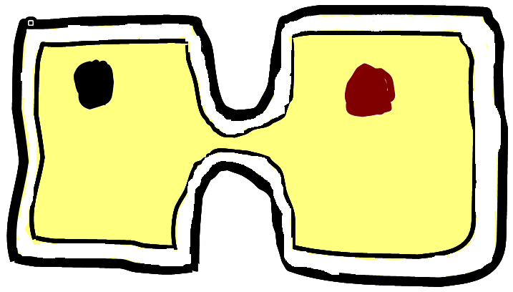
Binary Fission
The cell wall grows to divide the cell in two

Slide 6
Binary Fission
Two identical daughter cells are formed

Slide 8
Bacterial Reproduction
Bacteria reproduce asexually - their offspring are genetically identical
As there is little recombination of genetic material in this method of reproduction one would expect that bacteria would be slow to evolve
Bacteria has a very short lifecycle (some can reproduce every 20 minutes).
New mutations can spread very quickly
This is how bacteria evolve resistance to new antibiotics

Slide 9
Endospore formation
Some bacteria can withstand unfavourable conditions by producing endospores

Slide 10
Endospore formation
These are formed when the bacterial chromosome replicates

Slide 11
Endospore formation
The parent cell then breaks down and the endospore remains dormant

Slide 12
Endospore formation
One of the new strands becomes enclosed in a tough-walled capsule called an endospore
The parent cell then breaks down and the endospore remains dormant
Endospore

Slide 13
Endospore formation
When conditions are favourable the spores absorb water, break their walls and reproduce by binary fission

Slide 14
Reproduction of Prokaryotic cell

Slide 15
CONTENTS
Binary fission
Transformation
Transduction
Conjugation

Slide 16
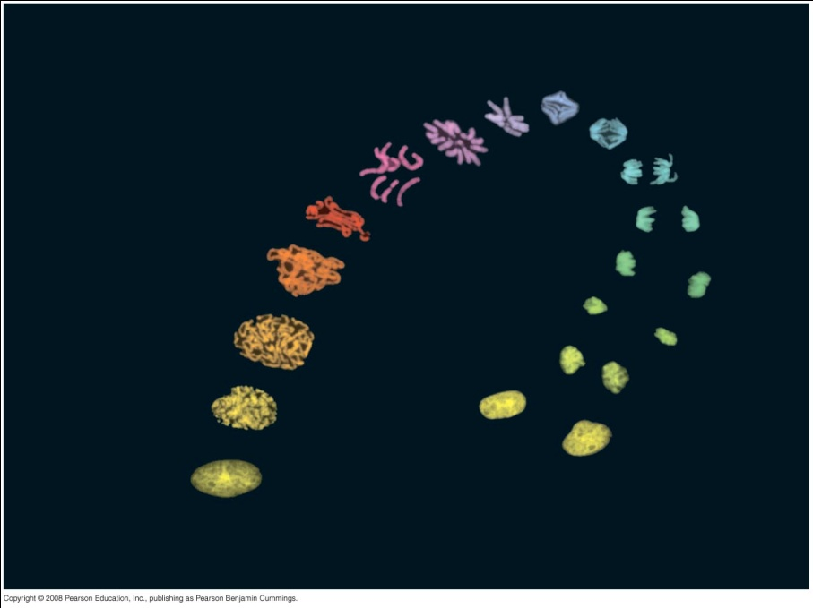
Overview: The Key Roles of Cell Division
The ability of organisms to reproduce best distinguishes living things from nonliving matter
The continuity of life is based on the reproduction of cells, or cell division
Copyright © 2008 Pearson Education, Inc., publishing as Pearson Benjamin Cummings

Slide 17
GROWTH AND CELL DIVISON
In unicellular organisms, division of one cell reproduces the entire organism
Microbial growth can be defines as the orderly increase in quantity of all cell components and in the number of cells of an organism.
Because of limited increase in cell size & the frequency of cell division, growth in microorganisms is measured by increased in cell number.

Slide 18
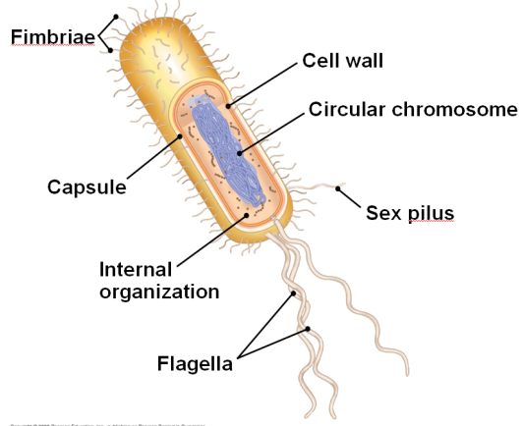
Genomic Organization
The prokaryotic genome has less DNA than the eukaryotic genome
Most of the genome consists of a circular chromosome
Some species of bacteria also have smaller rings of DNA called plasmids
The typical prokaryotic genome is a ring of DNA that is not surrounded by a membrane and that is located in a nucleoid region

Slide 19
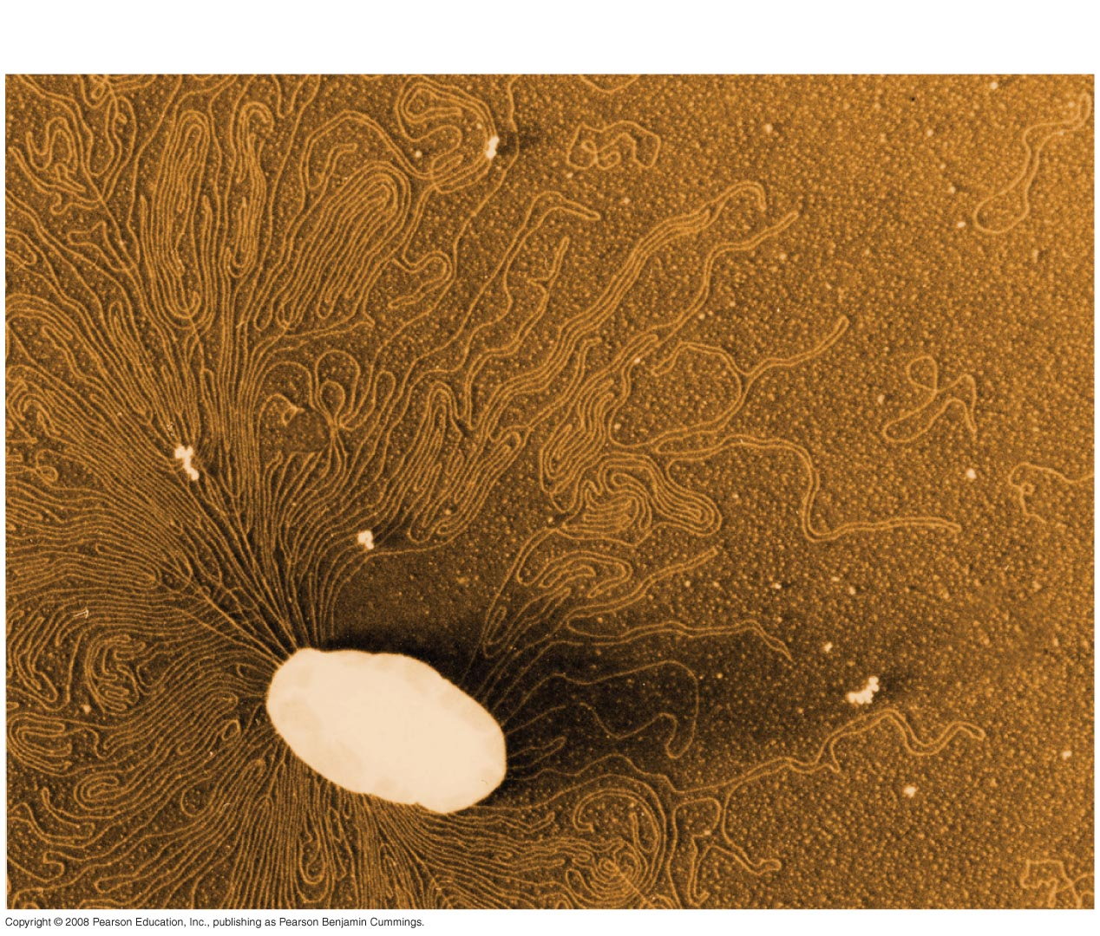
Fig. 27-8
Chromosome
Plasmids
1 µm
Notes:
Figure 27.8 A prokaryotic chromosome and plasmids

Slide 20

BINARY FISSION
Prokaryotes (bacteria and archaea) reproduce by a type of cell division called binary fission
Prokaryotes reproduce quickly by binary fission and can divide every 1–3 hours
In binary fission, the chromosome replicates (beginning at the origin of replication), and the cell form transverse septum that separates the two daughter chromosomes into two cells
Prokaryotes can evolve rapidly because of their short generation times
Copyright © 2008 Pearson Education, Inc., publishing as Pearson Benjamin Cummings

Slide 21
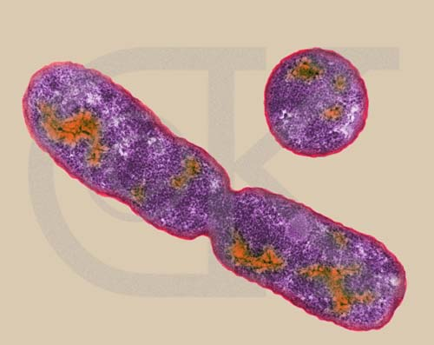
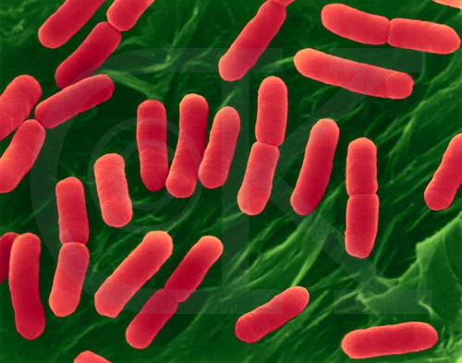
Binary Fission
Rod-Shaped Bacterium, E. coli, dividing by binary fission (TEM x92,750). This image is copyright Dennis Kunkel at www.DennisKunkel.com,
Rod-Shaped Bacterium, hemorrhagic E. coli, strain 0157:H7 (division) (SEM x22,810). This image is copyright Dennis Kunkel

Slide 22
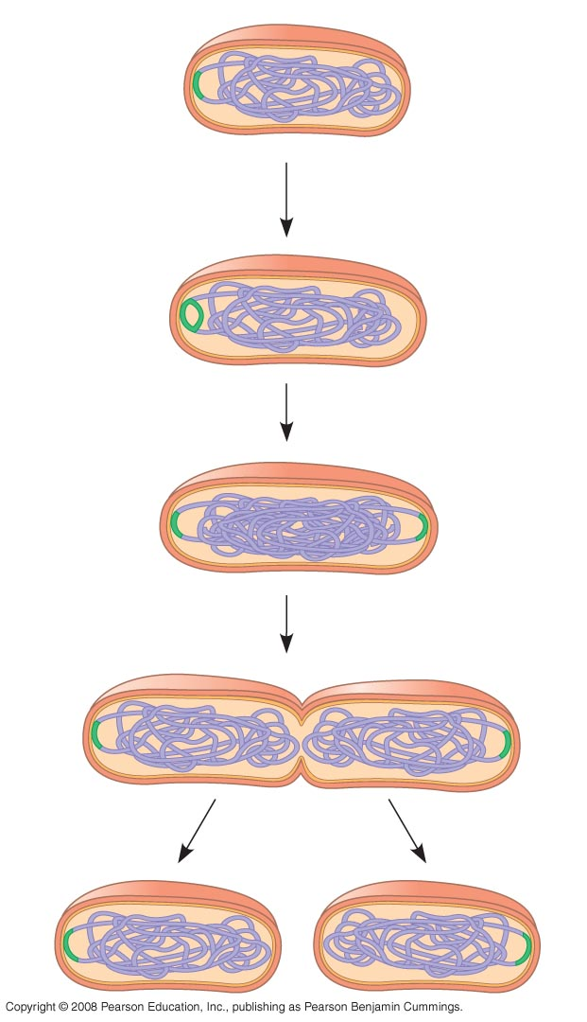
Bacterial cell division by binary fission
Cell wall
Origin of
replication
Plasma
membrane
E. coli cell
Bacterial
chromosome
Two copies
of origin
Chromosome replication begin origin moves rapidly towards the other end of the cell.
Replication continues. Meanwhile, the cell elongates.
Replication finishes. Septum form.The plasma membrane grows inwards. Anew cell wall is deposited.
Two daughter cell result
1
Origin
Origin
2
3
4
Notes:
Figure 12.11

Slide 23
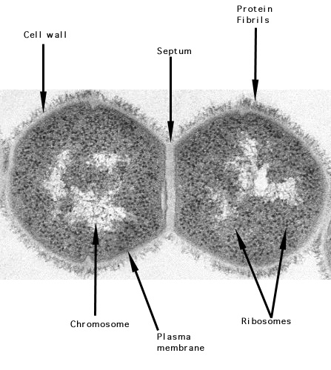
Electron micrograph of an ultra-thin section of a dividing pair of group A streptococci (20,000X). The cell surface fimbriae (fibrils) are evident. The bacterial cell wall is seen as the light staining region between the fibrils and the dark staining cell interior. Cell division in progress is indicated by the new septum formed between the two cells and by the indentation of the cell wall near the cell equator. The streptococcal cell diameter is equal to approximately one micron. Electron micrograph of Streptococcus pyogenes by Maria Fazio and Vincent A. Fischetti, Ph.D. with permission. The Laboratory of Bacterial Pathogenesis and Immunology, Rockefeller University.

Slide 24
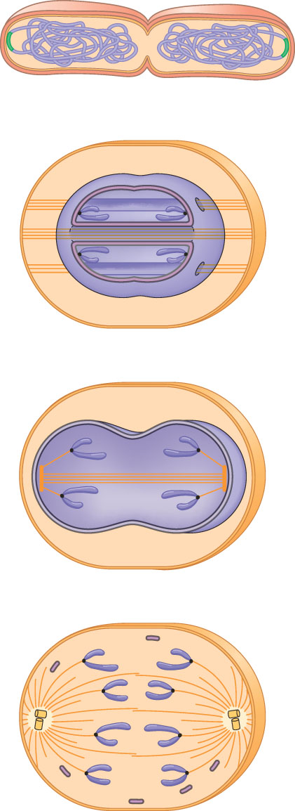
A hypothetical sequence for the evolution of mitosis
Prokaryotes. During binary fission, the origins of the daughter chromosomes move to opposite ends of the cell. The mechanism is not fully understood, but proteins may anchor the daughter chromosomes to specific sites on the plasma membrane.
(a)
Bacterial
chromosome
Dinoflagellates. In unicellular protists called dinoflagellates, the nuclear envelope remains intact during cell division, and the chromosomes attach to the nuclear envelope. Microtubules pass through the nucleus inside cytoplasmic tunnels, reinforcing the spatial orientation of the nucleus, which then divides in a fission process reminiscent of bacterial division.
Chromosomes
(b)
Microtubules
Intact nuclear
envelope
(c)
Diatoms. In another group of unicellular protists, the diatoms, the nuclear envelope also remains intact during cell division. But in these organisms, the microtubules form a spindle within the nucleus. Microtubules separate the chromosomes, and the nucleus splits into two daughter nuclei.
Kinetochore
microtubules
Intact nuclear
envelope
(d)
Most eukaryotes. In most other eukaryotes, including plants and animals, the spindle forms outside the nucleus, and the nuclear envelope breaks down during mitosis. Microtubules separate the chromosomes, and the nuclear envelope then re-forms.
Kinetochore
microtubules
Centrosome
Fragments of
nuclear envelope
Notes:
Figure 12.12 A hypothetical sequence for the evolution of mitosis

Slide 25
Rapid reproduction, mutation, and genetic recombination promote genetic diversity in prokaryotes
Prokaryotes have considerable genetic variation
Three factors contribute to this genetic diversity:
  Rapid reproduction
  Mutation
  Genetic recombination

Slide 26
Rapid Reproduction and Mutation
Prokaryotes reproduce by binary fission, and offspring cells are generally identical
Mutation rates during binary fission are low, but because of rapid reproduction, mutations can accumulate rapidly in a population
High diversity from mutations allows for rapid evolution

Slide 27
Genetic Recombination
Additional diversity arises from genetic recombination
Prokaryotic DNA from different individuals can be brought together by transformation, transduction, and conjugation

Slide 28
Transformation and Transduction
A prokaryotic cell can take up and incorporate foreign DNA from the surrounding environment in a process called transformation
Transduction is the movement of genes between bacteria by bacteriophages (viruses that infect bacteria)

Slide 29
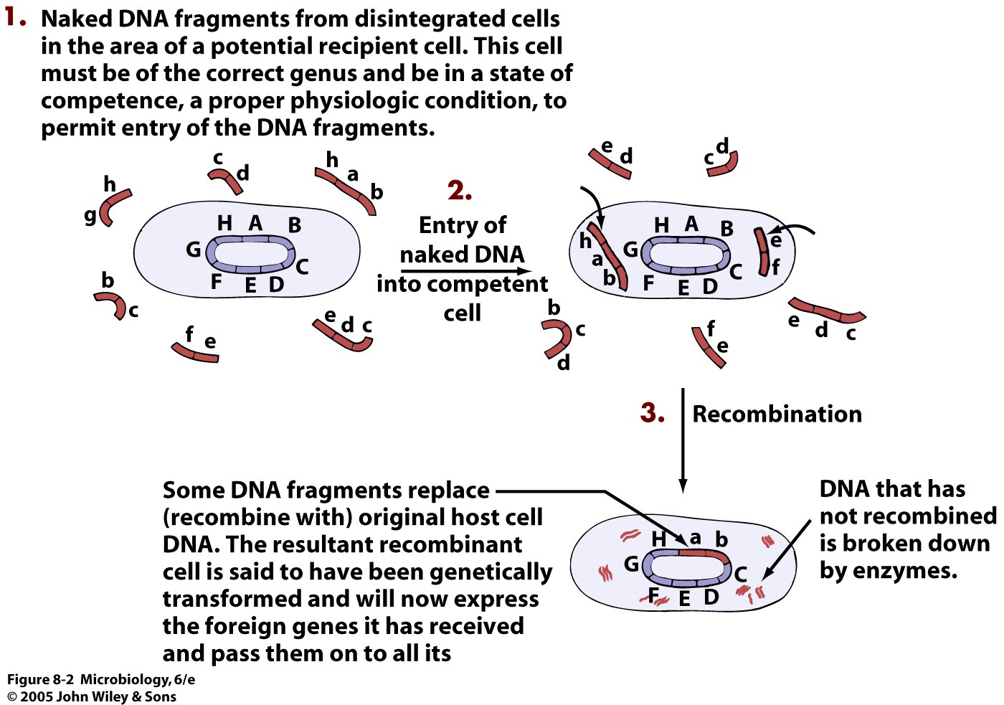
The mechanism of bacterial transformation

Slide 30
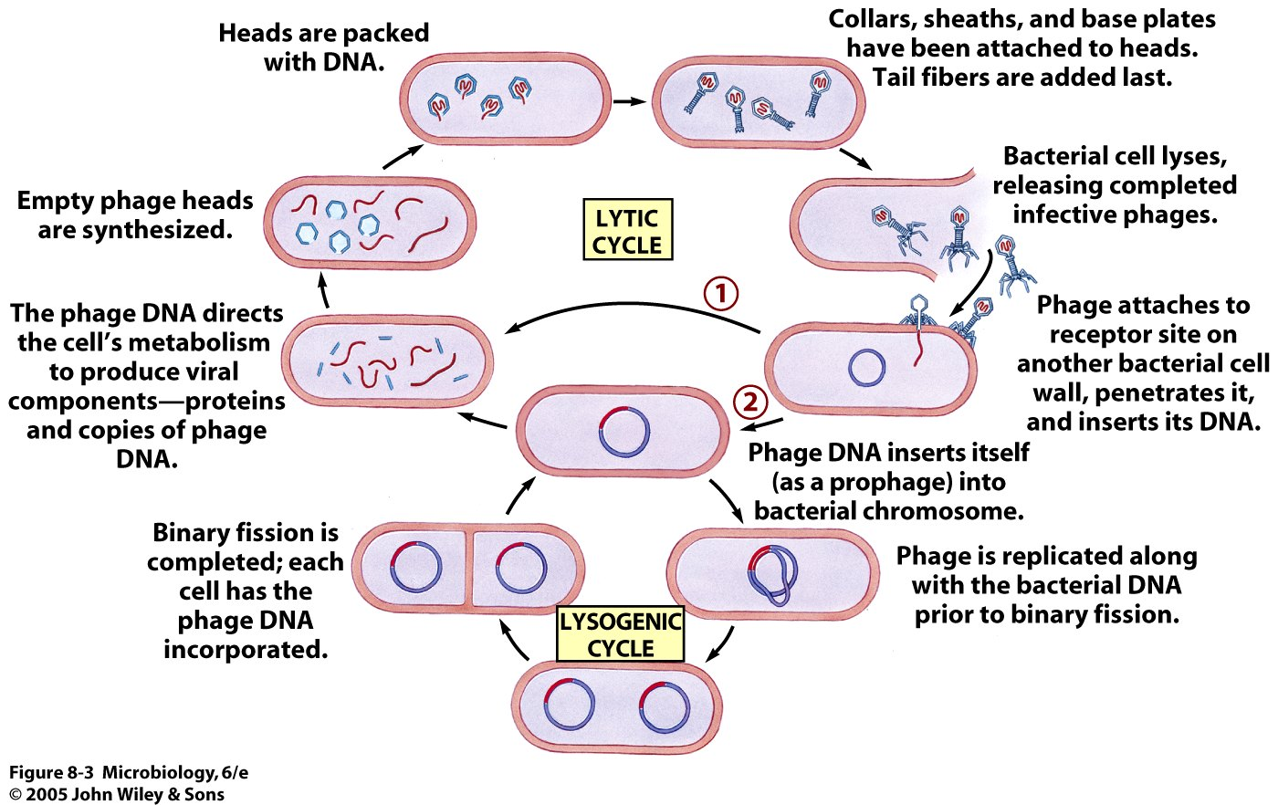
Bacteriophage Life cycle

Slide 31
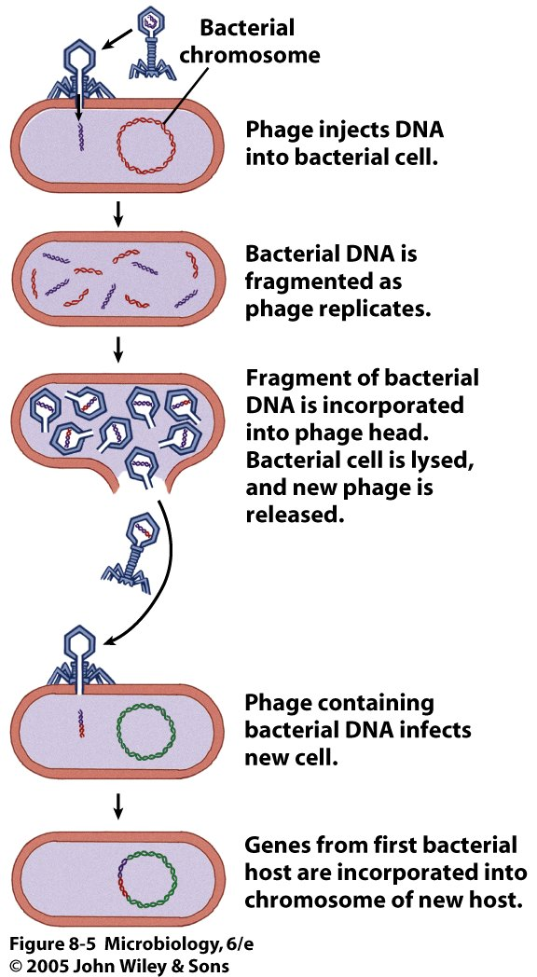
Generalized Transduction

Slide 32
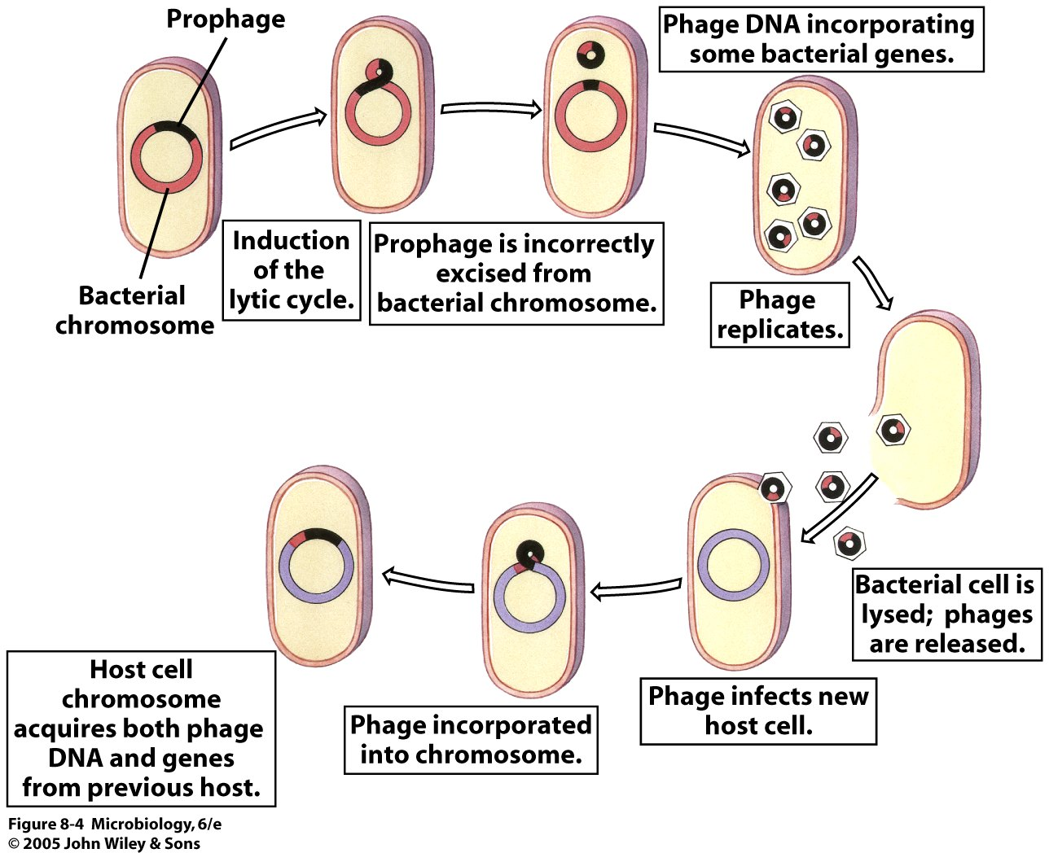
Specialized transduction by λ phage in E.coli

Slide 33
Conjugation and Plasmids
Conjugation is the process where genetic material is transferred between bacterial cells
Sex pili allow cells to connect and pull together for DNA transfer
A piece of DNA called the F factor is required for the production of sex pili
The F factor can exist as a separate plasmid or as DNA within the bacterial chromosome

Slide 34
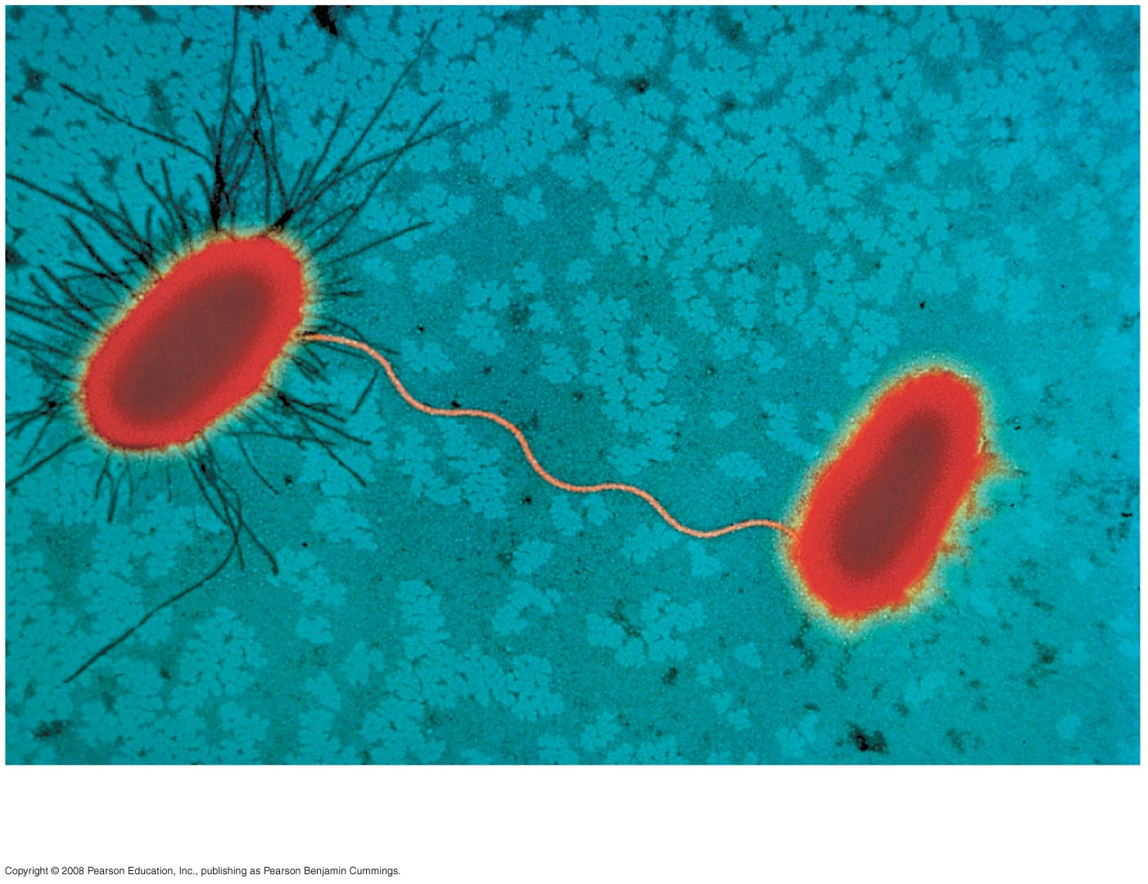
Fig. 27-12
Sex pilus
1 µm
Notes:
Figure 27.12 Bacterial conjugation

Slide 35
The F Factor as a Plasmid
Cells containing the F plasmid function as DNA donors during conjugation
Cells without the F factor function as DNA recipients during conjugation
The F factor is transferable during conjugation

Slide 36
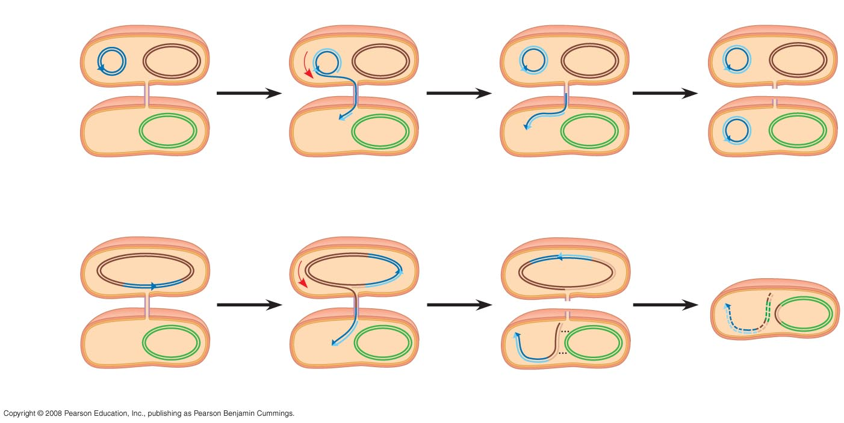
Fig. 27-13
F plasmid
Bacterial chromosome
F⁺ cell
F⁺ cell
Mating
bridge
F– cell
Bacterial
chromosome
F⁺ cell
(a) Conjugation and transfer of an F plasmid
Recombinant
F– bacterium
Hfr cell
A⁺
A⁺
A⁺
F factor
A⁺
A–
A⁺
F– cell
A–
A–
A⁺
A–
(b) Conjugation and transfer of part of an Hfr bacterial chromosome
Notes:
Figure 27.13 Conjugation and recombination in E. coli

Slide 37
The F Factor in the Chromosome
A cell with the F factor built into its chromosomes functions as a donor during conjugation
The recipient becomes a recombinant bacterium, with DNA from two different cells
It is assumed that horizontal gene transfer is also important in archaea

Slide 38
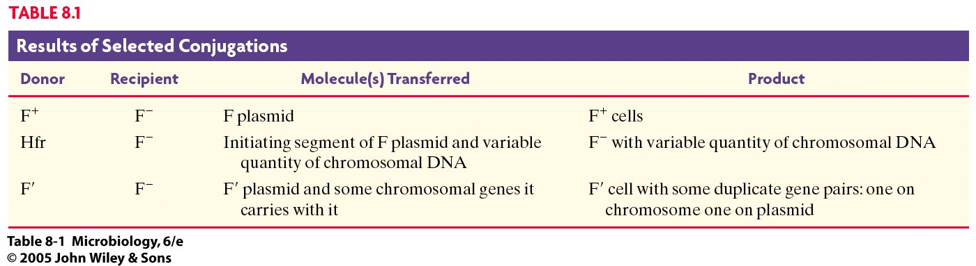

Slide 39
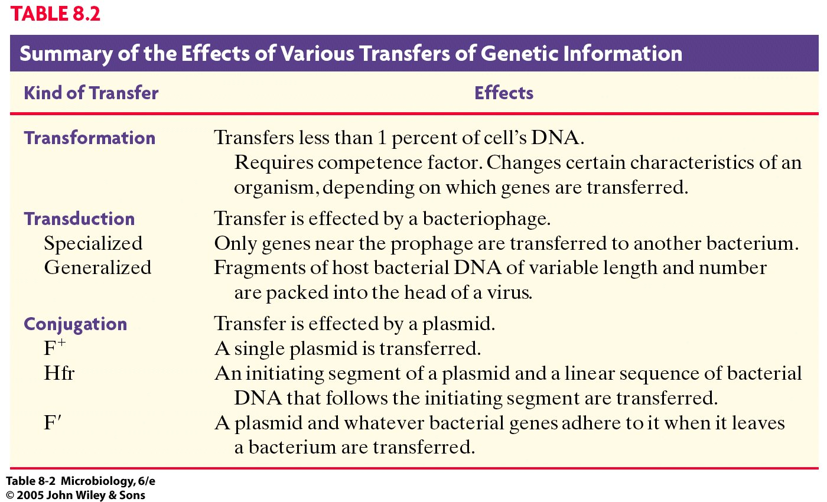

Slide 40
THANK YOU

